Slide 1
Employee Data Analysis using Excel
STUDENT NAME:
REGISTER NO: 312209893[asunm136331220983]
DEPARTMENT:
COLLEGE:
DEEPIKA.Y
B.COM bank management
Valliammal College for Women
1
Notes:
1

Slide 2
PROJECT TITLE
Employee Performance Analysis using Excel

Slide 3

AGENDA
Problem Statement
Project Overview
End Users
Our Solution and Proposition
Dataset Description
Modelling Approach
Results and Discussion
Conclusion

Slide 4

PROBLEM STATEMENT
. Utilize Excel to efficently analyse employee data by leveraging
Function such as PIVOT TABLES, nad conditional formating.
. The enables the identification of key trends, such as current
Employees rates, performance levels.
Desicion-making processes by visualization this data through
Pie chart

Slide 5

PROJECT OVERVIEW
.
This project focuses on analysing employee data to identify trends and
And insights that can drive better decision.
Excel will be used to clean, organize, and visuzalise kry metrics such as
Employee demographics, performance, and rention rates.
The analysis will highlights areas of improvemnet in workforce management
Helping to optimize resource allocation.
Outcomes will iclude detailed reports and dashboard for management
Review.
The finding aim to support stratergic planning.

Slide 6
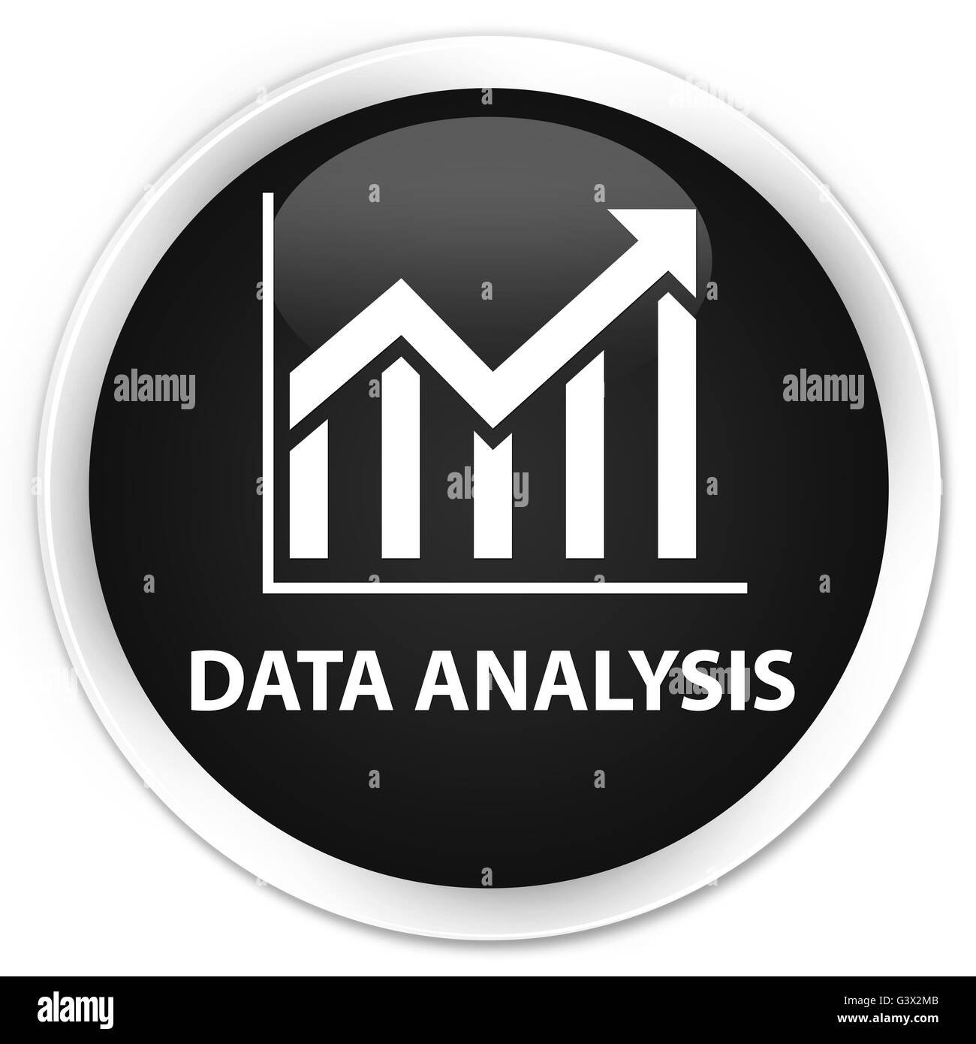
WHO ARE THE END USERS?
The end users of the employee data employee data analysis are HR
Managers team leads and senior management.

Slide 7

OUR SOLUTION AND ITS VALUE PROPOSITION
Conditional formatting – highligths missing cells
Filter – helps to remove the empty cells
Formulas – helps to identify the performance of emloyees
Pivot table – helps summarize
Pie chart – shows the data

Slide 8
Dataset Description
1. Employee ID
2. First name
3. Last name
4. Business unit
5. Employee classification type
6. Employee type
7. Gendor
8. Performance score
9. Current employee rate
10. Performance level

Slide 9

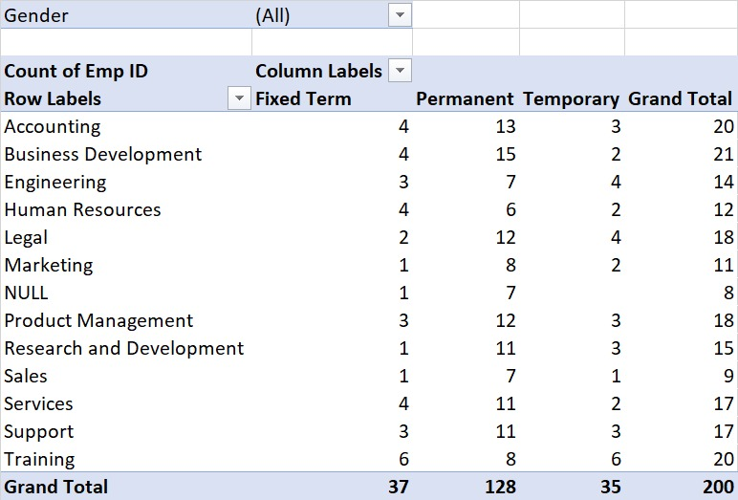
THE "WOW" IN OUR SOLUTION

Slide 10
MODELLING
DATA COLLECTION
*Identification
*Gathering
*Preparation
DATA CLEANING
*Standarization dization
*Correction
*Validation
SUMMARY
Data analysis involves examining, transforming, and modeling data to
Extract insights , identify patterns, and support decisions-making.

Slide 11
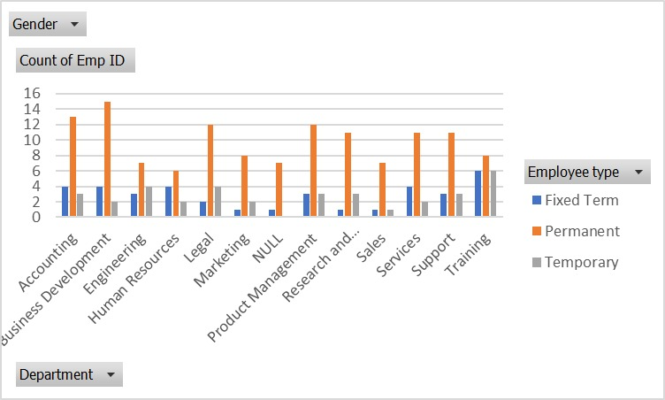
RESULTS

Slide 12
conclusion
* IN CONCLUSION, the employee data analysis conducted using Excel
Provided valuable insights into workforce trends enabling more
Infromed decision-making.
The use of Excel allowed efficient data organization, visualization
and reporting, ultimately helping to enhance HR strategies, improve
and employee satisfaction and optimize overall organizational
performance.

